Slide 1

Progressive Education Society's Modern College of Engineering, Pune-5 Department of MCA
Project Presentation
On
“Placement Portal”
By
Sagar Patil-52142
Aniketsingh Rajput-52146
Nitesh Rajpurohit-52145
Spoorti Moorbandi – 52134
Under the Guidance of
Mrs Rama Bansode
PES MODERN COLLEGE OF ENGINEERING, MCA DEPARTMENT, A.Y. 2024-25

Slide 2
Contents
Steps of Project Designing and Development
Research your users' needs
Ideate, Challenge assumptions and create ideas
AS-IS system(Existing System)
AS-IS system limitations
Project Introduction
TO-BE system (Proposed System)
Entity Relationship Diagram
Data Flow Diagrams
Screen layouts
Reports
Limitations & future Enhancements

Slide 3
Research your users' needs
The users of this system are primarily the Admin, Students, and Placement Cell of an educational institution. Their needs are:
Admin: To manage and oversee placement processes, including approving drives, managing student profiles, and posting notices.
Students: To upload their academic information, view placement opportunities, apply for drives, and communicate with coordinators.
Placement Cell: To coordinate drives with companies, manage applications, and communicate updates with students and admin.

Slide 4
Ideate, Challenge assumptions and create ideas
To enhance the Placement Management System, we could:
Introduce a feedback loop to gather user input.
Ensure data security through encryption and role-based access controls.
Incorporate advanced analytics to predict student placement success rates.
Implement AI-driven resume suggestions to improve student profiles.
Allow for mobile accessibility to improve ease of use.

Slide 5
AS-IS system(Existing System)
The current system is a Placement Management System with three main modules:
Admin: Manages users and placement drives.
Students: Manages profiles, views drives, and communicates.
Placement Cell: Coordinates placement activities and manages applications.

Slide 6
AS-IS system limitations
The Limitations are:
Limited user feedback mechanism.
Lack of robust data encryption.
Basic user interface with limited mobile accessibility.
No provisions for scalability in handling a growing user base.

Slide 7
Project Introduction
The Placement Management System is a web application for the training and placement department of our college. This system can be accessed throughout the organization with proper login credentials. Students will be able to upload their personal and educational information which will be managed efficiently by the system. It intends to provide a fast access to the placement procedures and related activities and ensures to maintain the details of the student secure. The key feature of this project is that it is a onetime registration enabled system. This project will aid colleges to practice full IT deployment. Separate Login Page For Admin, Coordinator and Student Interactive Dashboard Coordinator can Update the drive and check the applied and modify accordingly Admin can Approve and reject request of All type of registration Admin can post notice to all students and coordinator separately upload technical papers View Student and Company Profile Interactive Contact us Page.

Slide 8
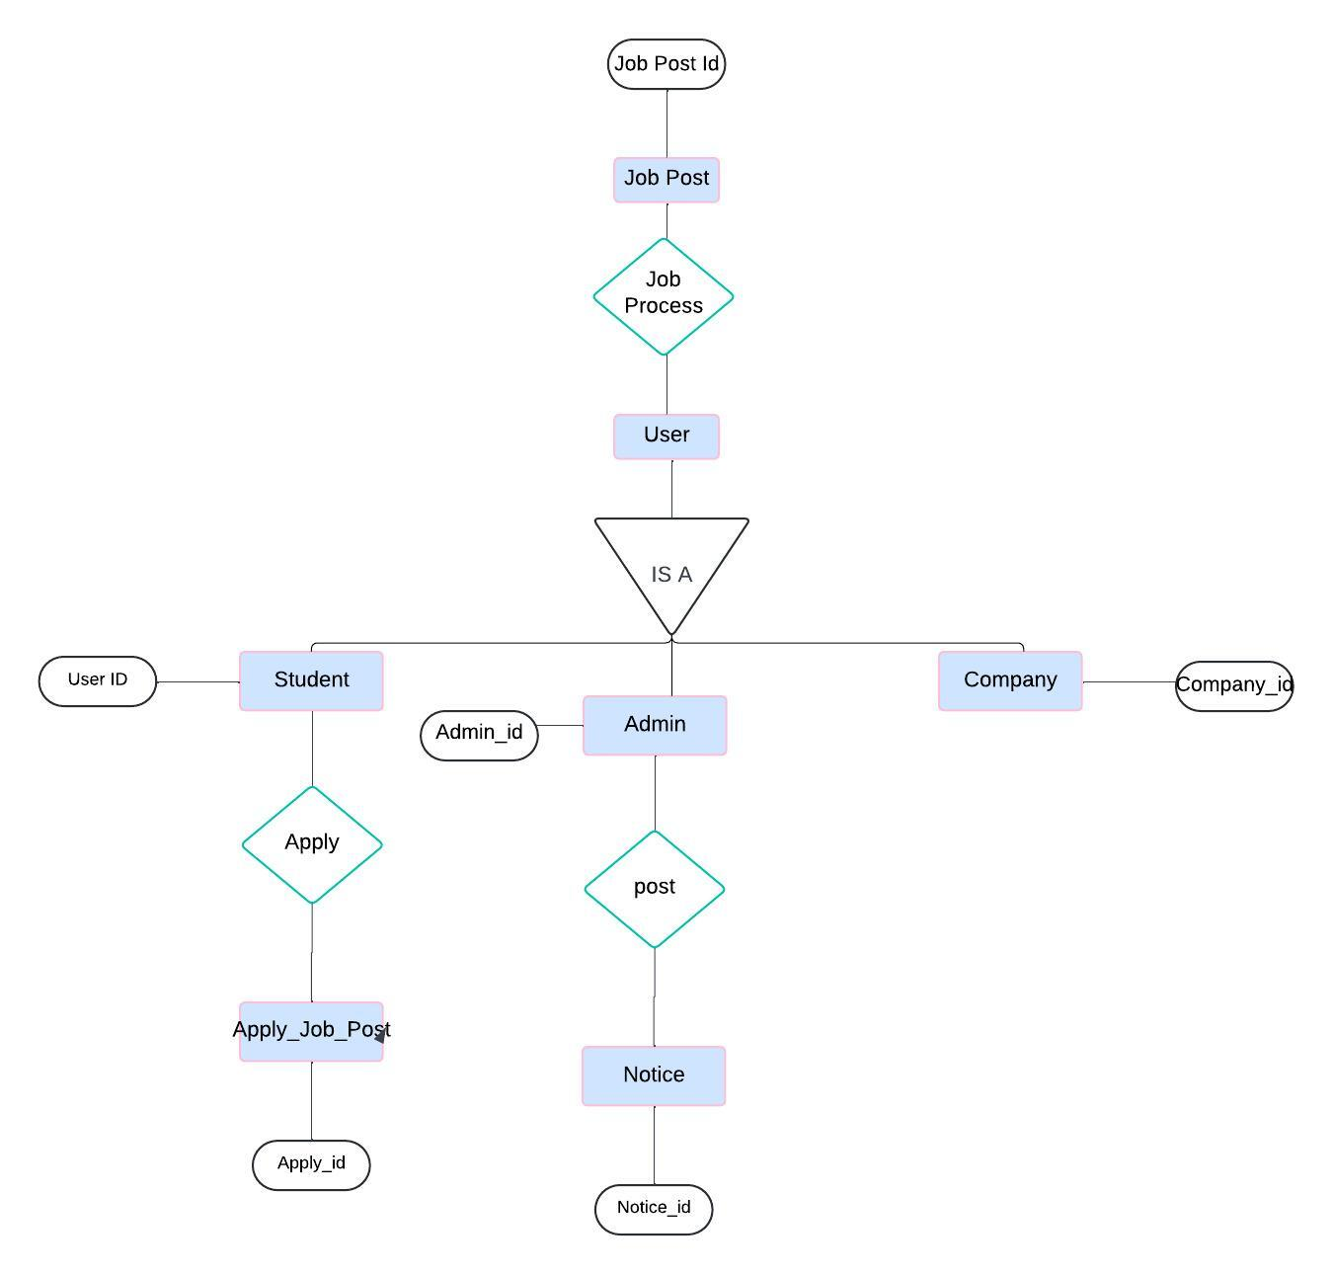
Entity Relationship Diagram

Slide 9
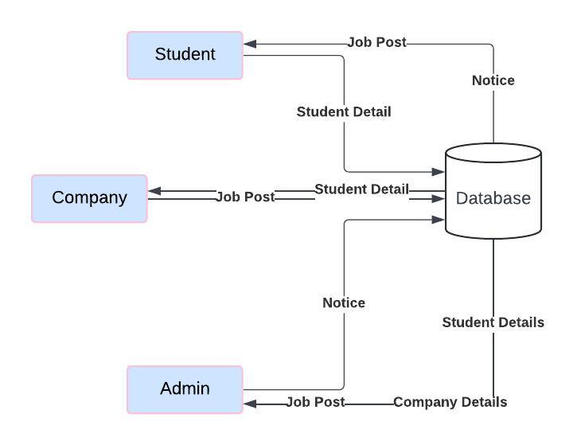
Data Flow Diagrams

Slide 10
TO-BE system (Proposed System)
The proposed system builds on the AS-IS system but introduces:
Advanced Security: Data encryption and compliance with privacy regulations.
Enhanced User Interface: Mobile-friendly design with smoother navigation.
Scalability: Built to handle an increasing number of users and data.
Efficiency : Streamlines placement process
Security :Ensures the confidentiality and security of student data.
Transparency: Facilitates seamless and transparent communication among Admin, Students, and the Placement Cell
Data-Driven Decisions : Informed strategies for future placements.

Slide 11
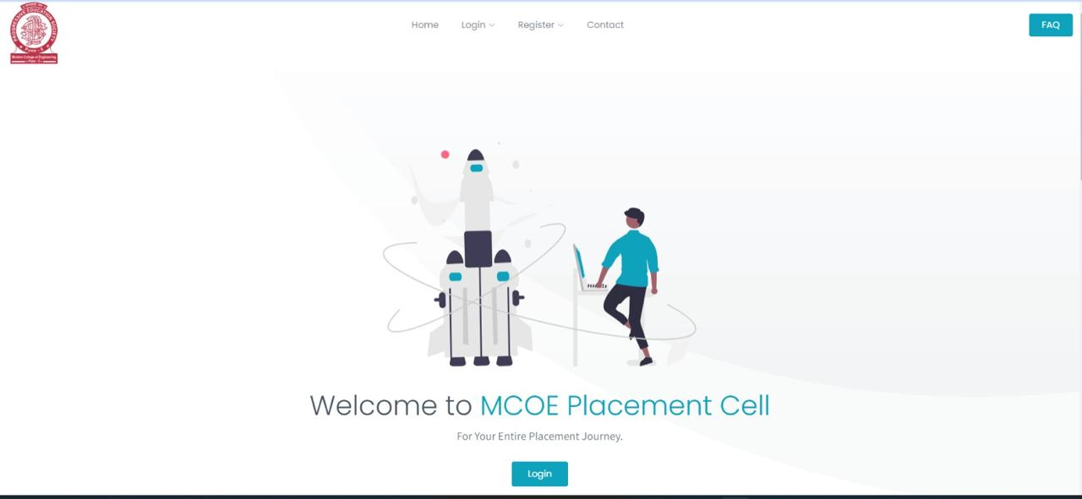
Screen Layouts:-

Slide 12
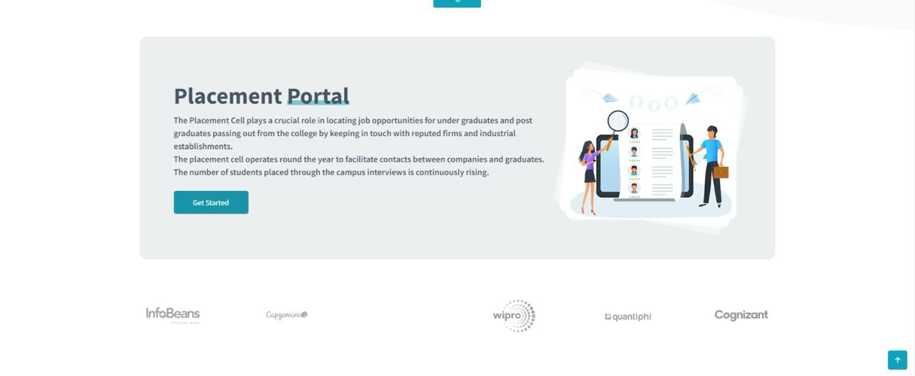

Slide 13
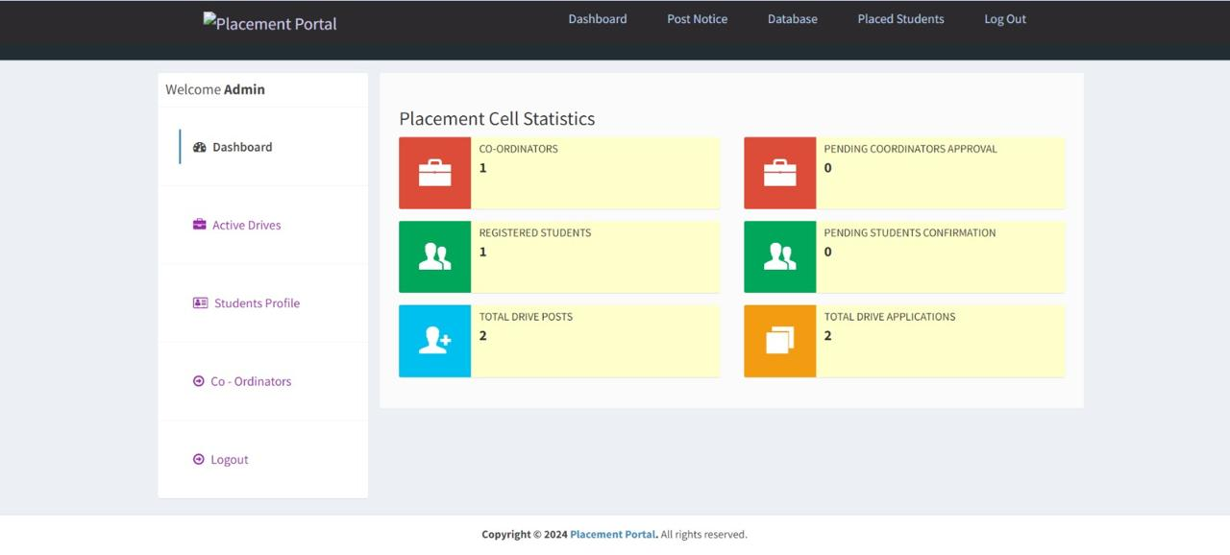

Slide 14
Reports
Reports are vital for tracking progress, assessing performance, and making informed decisions within a project management system. Placement Portal provides reports that cater to different user roles.
1. Placement Statistics: Admin can generate reports on student applications and placement outcomes.
2. Drive Reports: Reports on the status of placement drives and student participation.

Slide 15
Limitations & Future Enhancements
Future Enhancement
Integrate AI for smart recommendations.
Enhance user feedback mechanism for continuous improvement.
Expand data security features to ensure compliance with privacy laws.
Ensure scalability for growing user numbers.
Limitations
Basic user interface.
Limited scope for user feedback.
No AI-driven features for intelligent suggestions.

Slide 16
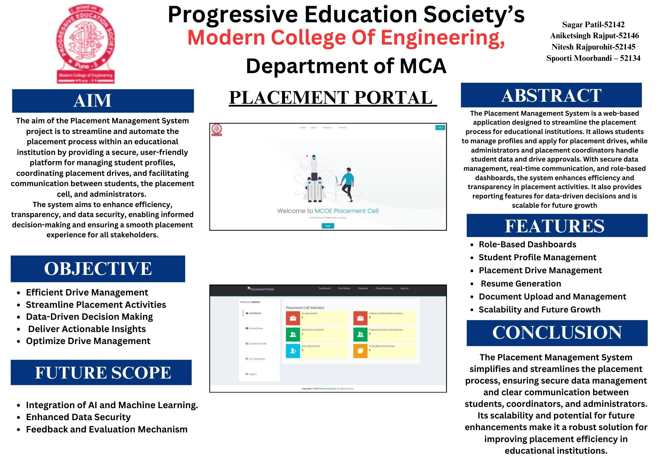
One Page PPT

